Slide 1


Team Members:
Louie Labellarte
Kalyani Shinde
Niharika Verma
Ritika Verma
Nov 30, 2023

Slide 2
Intro

Slide 3
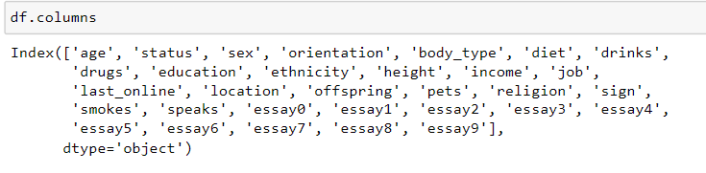
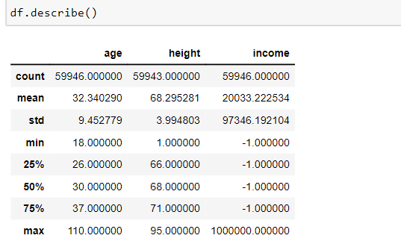

Dataset Description
nhvhvhv

Slide 4
Cleanup

Slide 5
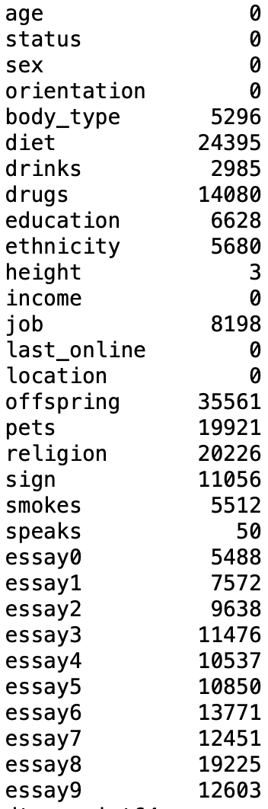
NaN Counts Per Column

Slide 6
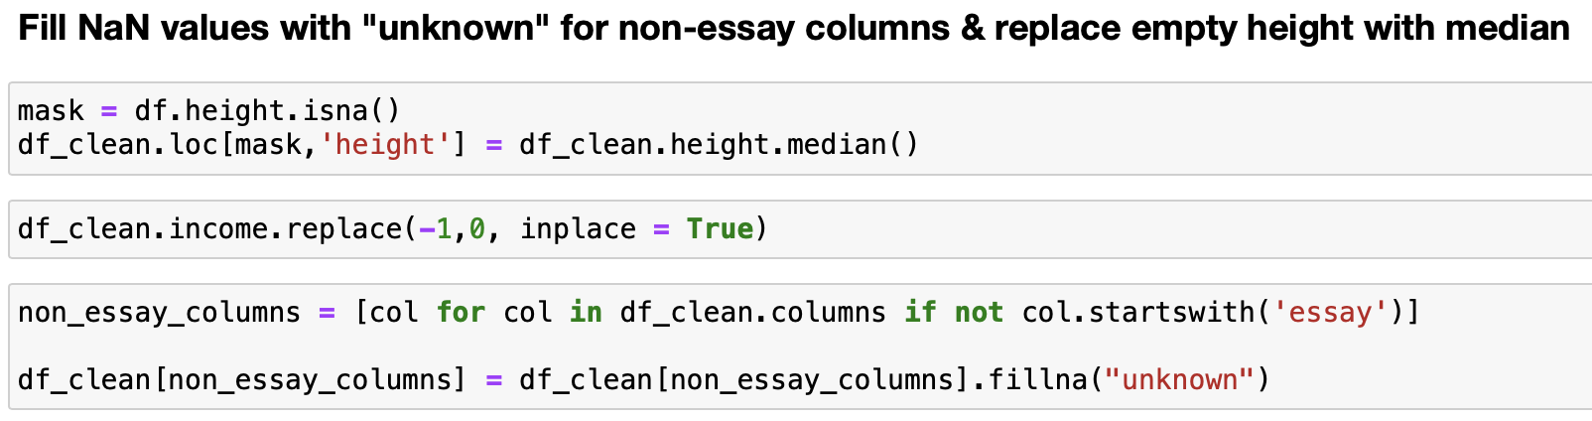
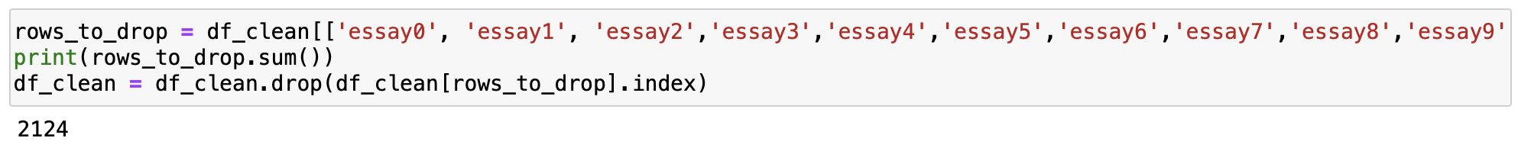
Dealing with NaNs
Notes:
Addressed nans by filling them with the label “unknown” Fill nans in height column with the median height. Replace -1 with 0 in income column.’ We decided to drop the rows that had no information in any of the essay columns because we plan to perform sentiment analysis on these features.

Slide 7
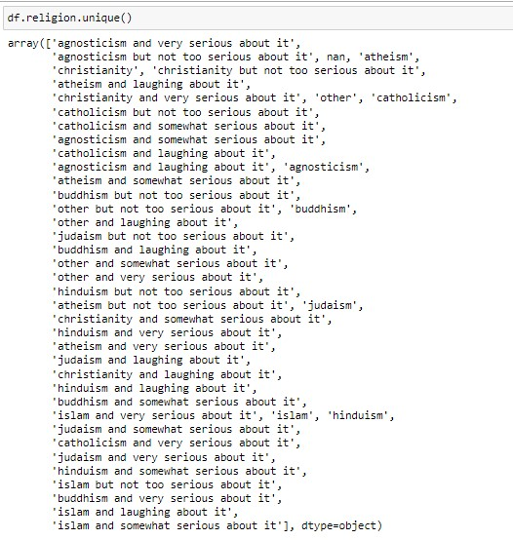

Slide 8
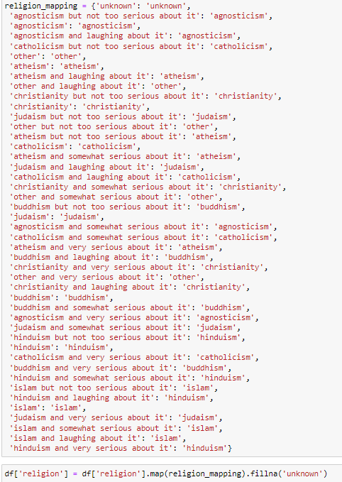

Reducing Size of Categorical Features
After using map() function

Slide 9
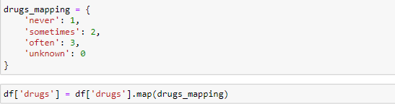

Slide 10
Income Findings

Slide 11
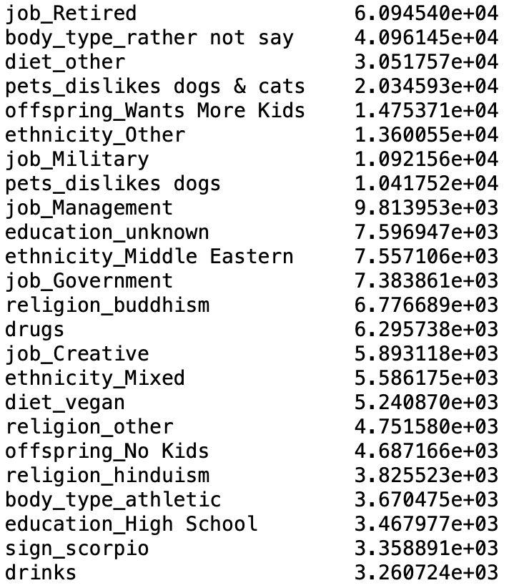
Lasso Regression
Motivation:
Determine the features that have highest weight in the prediction of income
Knowing these features could help OkCupid to push premium subscription packages to high earning customers even if they do not list their income
Notes:
Based on the coefficients provided by Lasso we chose to look into Job type, Pet preference, and kid preferences, and drugs and drinking habits. We chose to avoid looking into protected attributes involving ethnicity like religion and diet. We avoided drawing conclusions with these features so that our recommendations would be ethical and actionable.

Slide 12
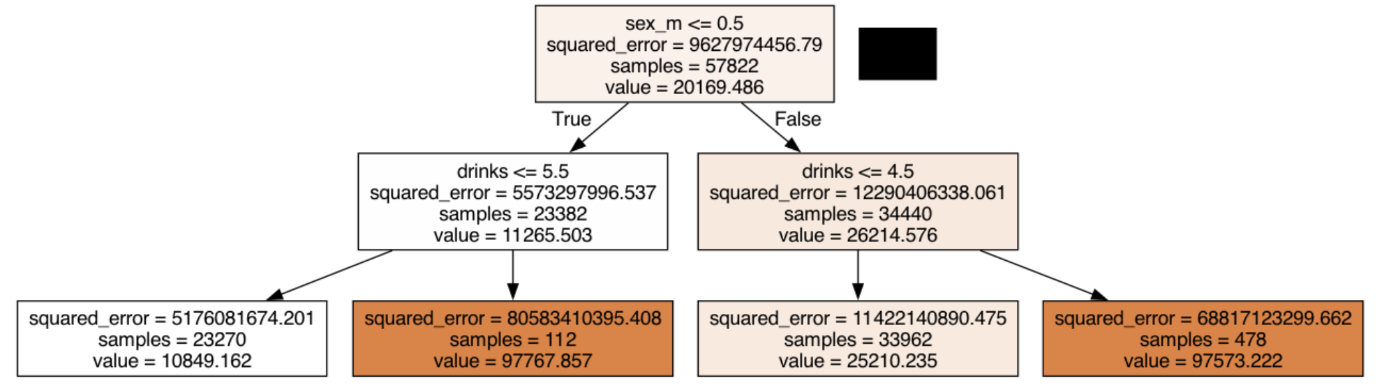
Decision Tree Regressor
Notes:
The squared error scores are unusually high. We believe that this may be because the income values are imbalance. Over 80% of individuals list their income as 0. In light of this, we can see that the decision tree regressor chooses sex and drink frequency as the main determinants of income level which corresponds to the coefficient weights found in lasso. This reinforces our decision to look into lifestyle choices like drinking and drug habits.

Slide 13
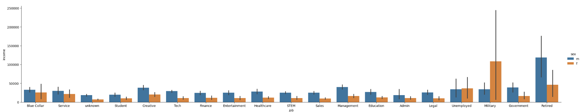
Income by Job
Notes:
We see that retired individuals make the most out of all job types. This is slightly idiosyncratic because we would expect people currently in the workforce to have higher incomes than those who do not work. We also see that women in the military make much more money on average than women in any of the other job types.

Slide 14
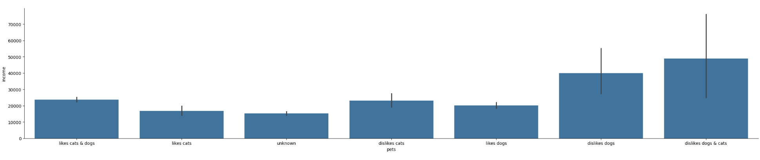
Income by Pets Preferences
Notes:
Interestingly, we see that people who claim to dislike dogs make much more money than those who like dogs. One possible explanation is that high earners don’t have time to care for high maintenance animals like dogs. The explanation could be more psychological, commenting on a potential lack of empathy in the highest earners in the workforce.

Slide 15
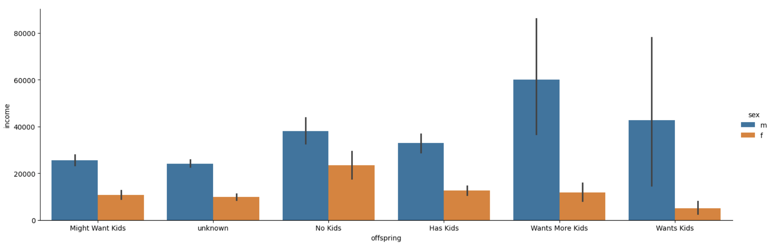
Income by Kids Preferences
Notes:
The trend between income and kid preferences on the other hand makes more sense. People who want kids make more money. It makes sense that people who can justify having kids would have the resources to support a child.

Slide 16
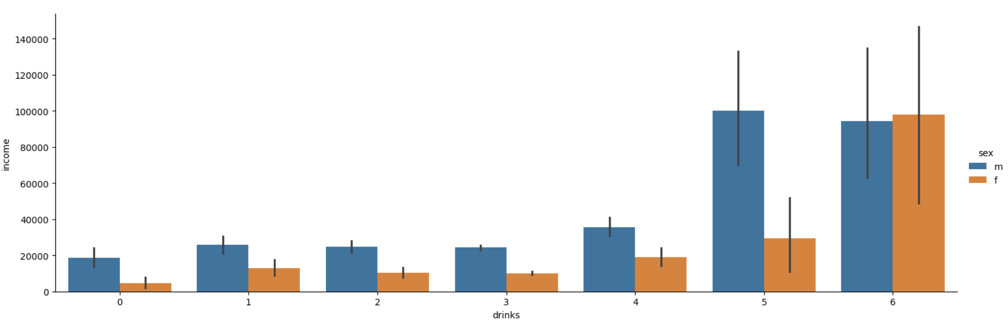
Income by Drinking Frequency
Notes:
As reinforced by the decision tree, drinking has a strongly positive relationship with income after level 4. We see that men who drink frequently and desperately have the same high income distribution. In contrast, women have roughly the same level of income between levels 1 and 5, but average income dramatically increases for women who drink at the highest frequency. Here we can confidently say that men who drink at the top two highest levels on average earn the highest salaries. Women who drink at the highest level earn the highest salaries.

Slide 17
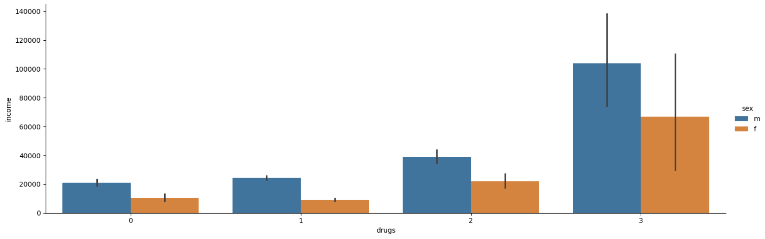
Income by Drug Use Frequency
Notes:
Again, we see a clear positive relationship between drug use and income. This relationship is more stark compared to drinking. Level 1 means no drugs, level 2 is some, and level 3 is frequent drug use. We see an immediate jump in income from level 1 to level 2, and an exponential jump in income between levels 2 and 3

Slide 18
Income Coefficient Conclusions
Correlated Features:
Jobs: retired, women in the military
Pets: individuals who dislike dogs
Kids: individuals who want kids
Drinks: men at the top two frequencies, women at the highest frequency
Drugs: individuals who do more drugs
Managerial Recommendation:
OkCupid sales teams can use the patterns found in these features to push premium subscription packages to presumed high earning individuals, even if income is not listed
Notes:
The distinct relationships that we discovered in the jobs, pets, kids, drinks and drug responses could help OkCupid sales teams to accurately predict income levels in the absences of explicit income information. In doing so, the sales team could target individuals whose responses meet the above criteria and presumably increase volume of premium subscription purchases. This information could also help sharpen the OkCupid match making algorithm, to match people at the highest income level regardless of the presence of explicit income information.

Slide 19
Essay Sentiment Analysis Findings

Slide 20
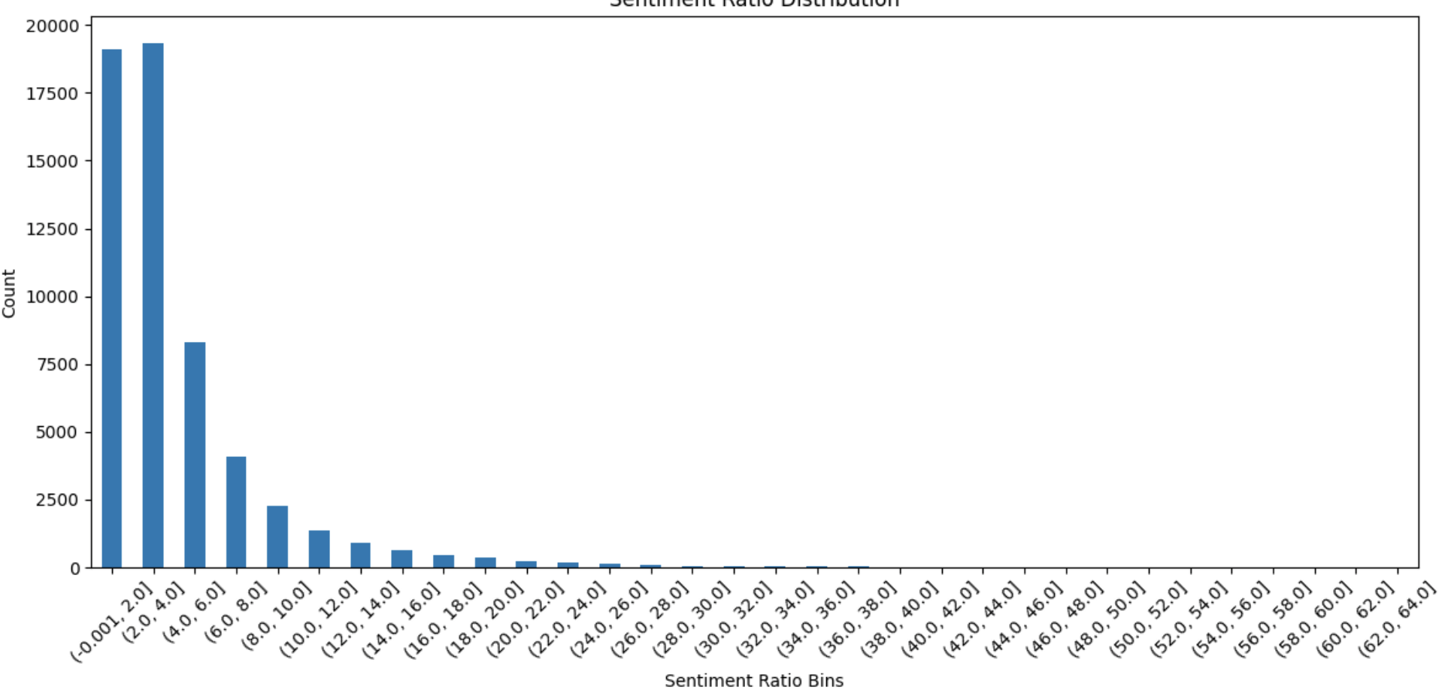
Distribution of Sentiment Ratio (Positive / Negative)
Notes:
Describe the column we created. It contains the ratio of positive words to negative words in all of the written response columns per row. Most individuals have a sentiment ratio between 1 and 4, indicating that people are generally positive. So what we decided to explore was what features contribute to the relative positivity between individuals.

Slide 21
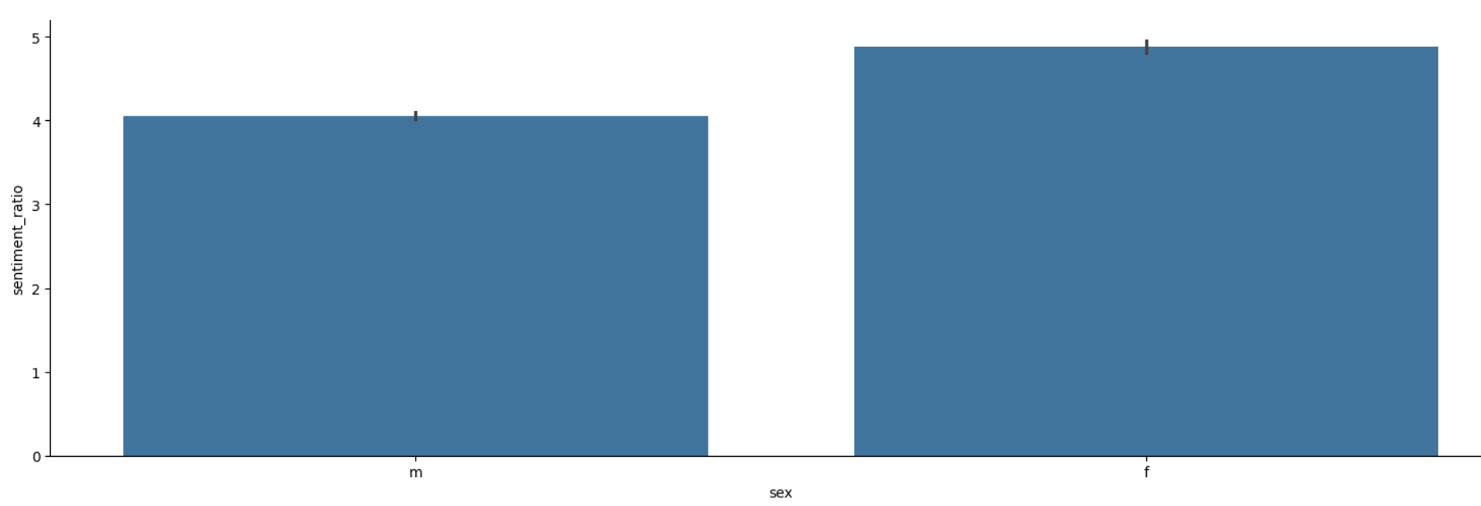
Sentiment Ratio by Sex
Notes:
Demographically, females are on average more positive than males

Slide 22
Features With Correlation to Sentiment Ratio
Age
Smokes
Drinks
Income
Notes:
Through exploring the correlations between sentiment ratio and the other features, we discovered interesting trends between sentiment ratio and age, the amount people smoke, the amount people drink. Using lasso, we found that age has the highest coefficient when predicting the sentiment ratio, and that income has some relationship with the prediction of income.

Slide 23
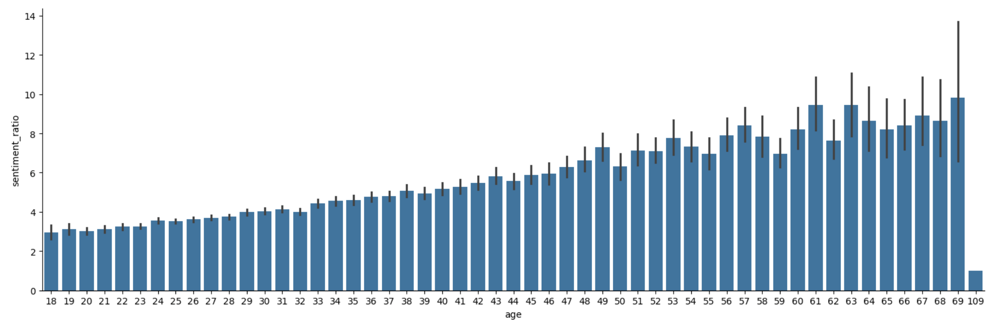
Age
Notes:
There is a clearly linear relationship between age and sentiment ratio. There might be some interesting sociological commentary for why this relationship exists. Perhaps it is cooler to be more negative when you are young (edgey). As individuals get older, positivity might be more attractive.

Slide 24
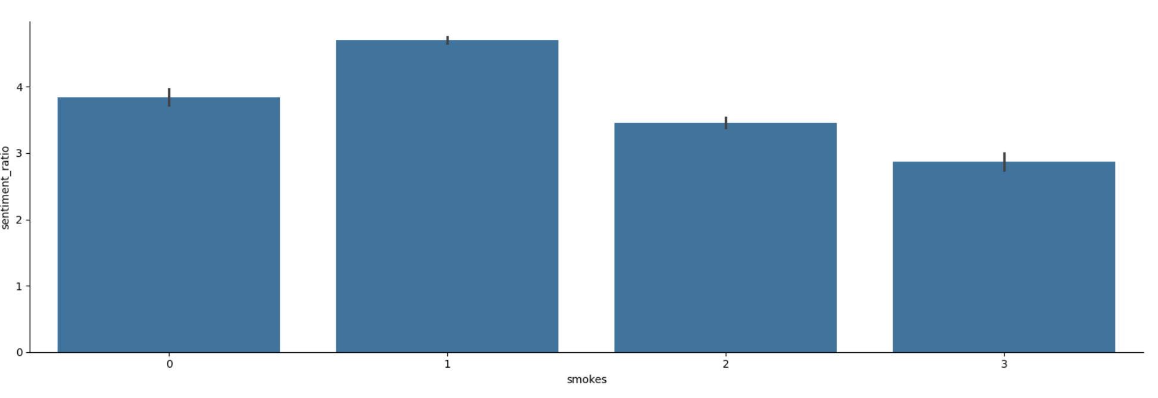
Smokes
Notes:
Interestingly, the more frequently people smoke, the less positive their essay responses are. This might relate to the reasons that individuals smoke to begin with.

Slide 25
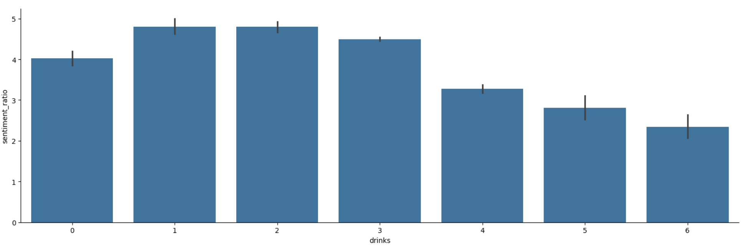
Drinks
Notes:
The same trend exists for drinking. The more people drink, the less positive their essay responses are.

Slide 26
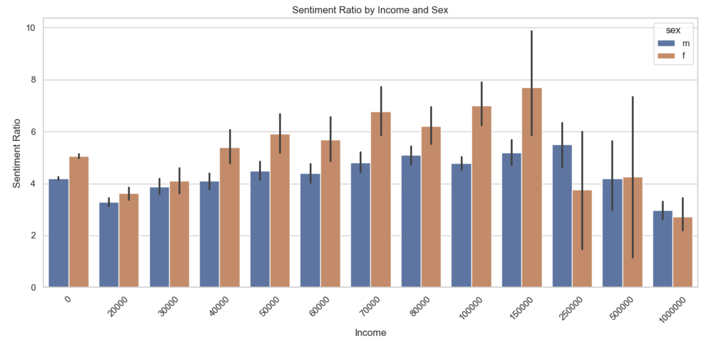
Income
Notes:
Lastly, Lasso regression showed that income has the highest coefficient as it relates to the prediction of sentiment ratio. As we can see, people become much more positive between income of 20000 and 150000. After 150000, positivity drops off. This might comment on the age-old adage that money cannot buy happiness after a certain point. We also see that this positive relationship is more dramatic for females as compared to males, however this might be because females are generally more positive than males.

Slide 27
Sentiment Ratio Conclusions
Correlated Features:
Age
Smokes
Drinks
Drugs
Income
Managerial Recommendation:
In the absence of essay responses, OkCupid algorithms should use the patterns in these features to extrapolate positivity for better matchmaking
Notes:
These five columns show us distinct relationships with the sentiment of individuals’ essay responses. These written responses require the most time and effort to fill out, so people are less likely to complete them when making their dating profiles. This is reflected in the amount of NaNs in these columns. We presume that matching positivity level is important to making a good match. Our proposal is that OkCupid uses the information in these four columns to create a sentiment score, in the absence of essay responses. As a result, the OkCupid algorithm could make help create more fitting matches on the basis of sentiment ratio between individuals who do not fill out essay responses.

Slide 28
User Profiles: Completeness & Reliability Analysis

Slide 29
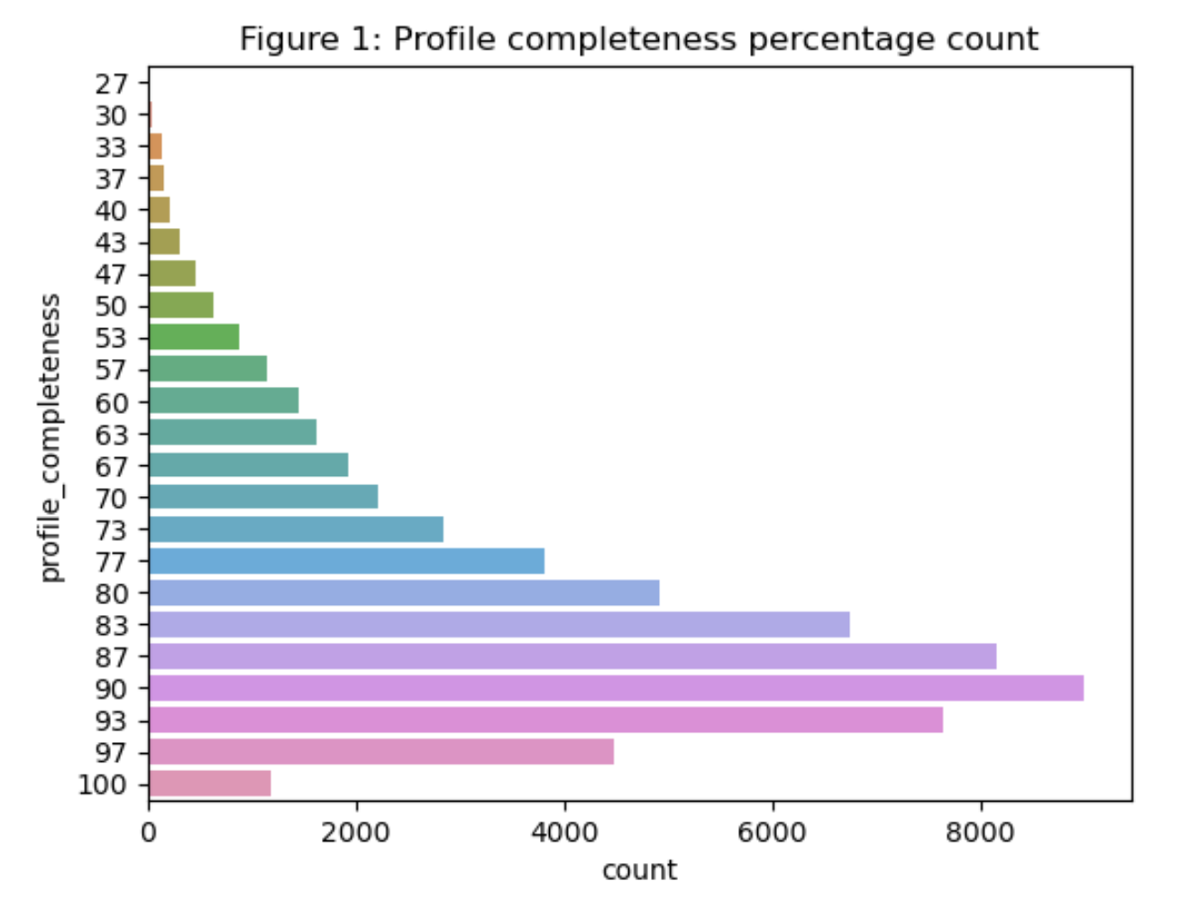
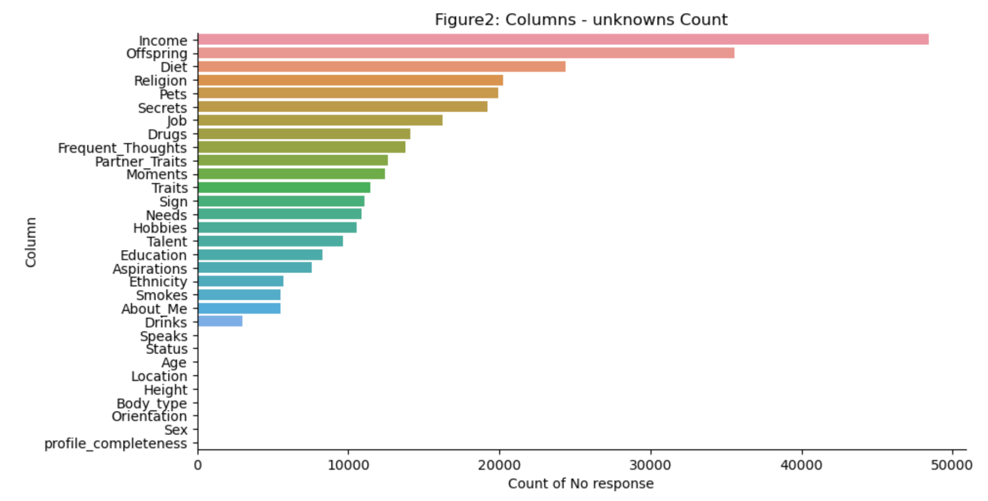
Profile completeness per column

Slide 30
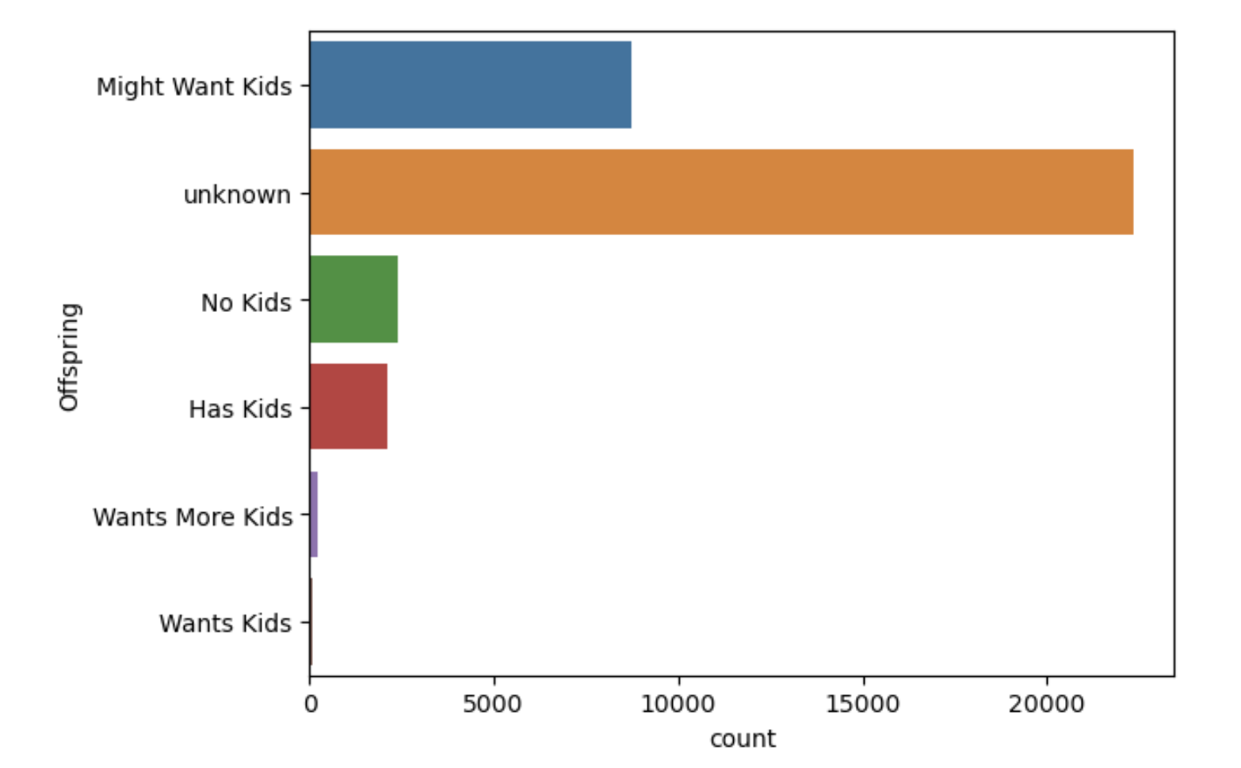
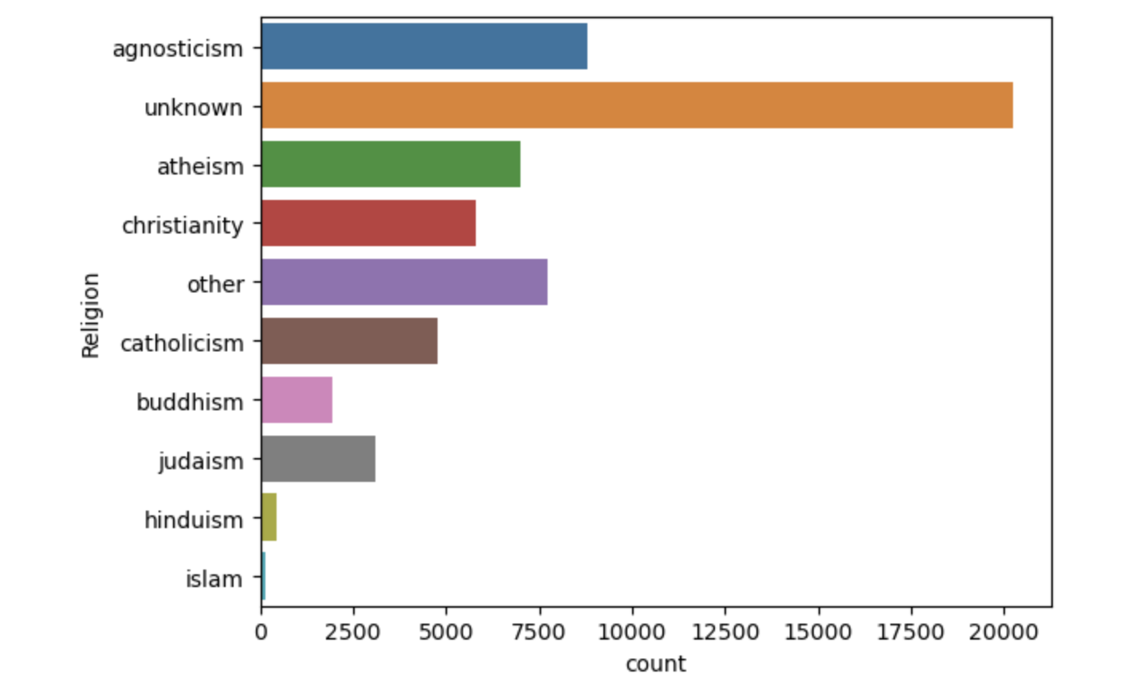
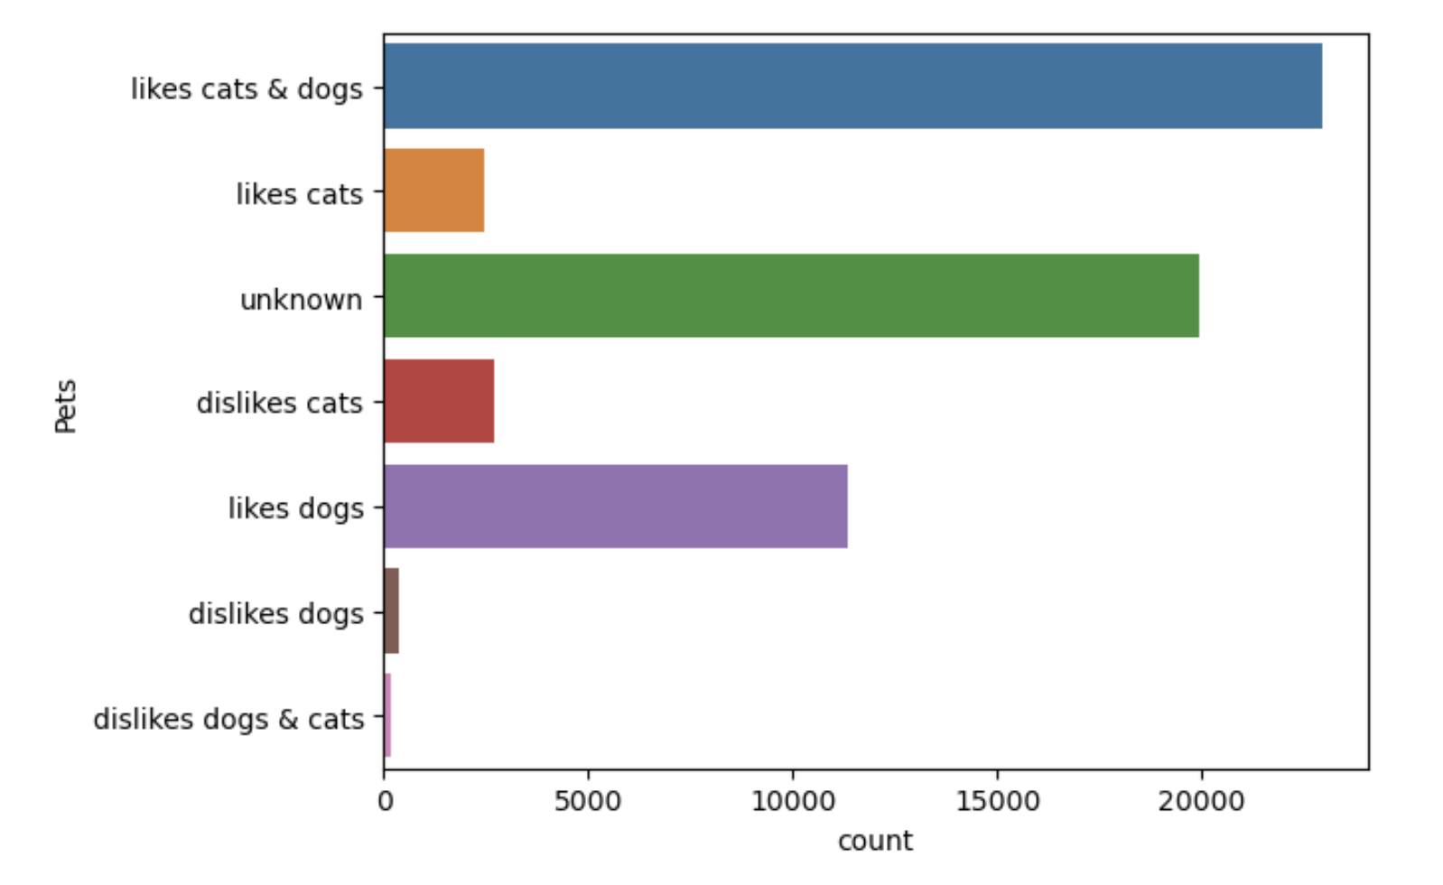
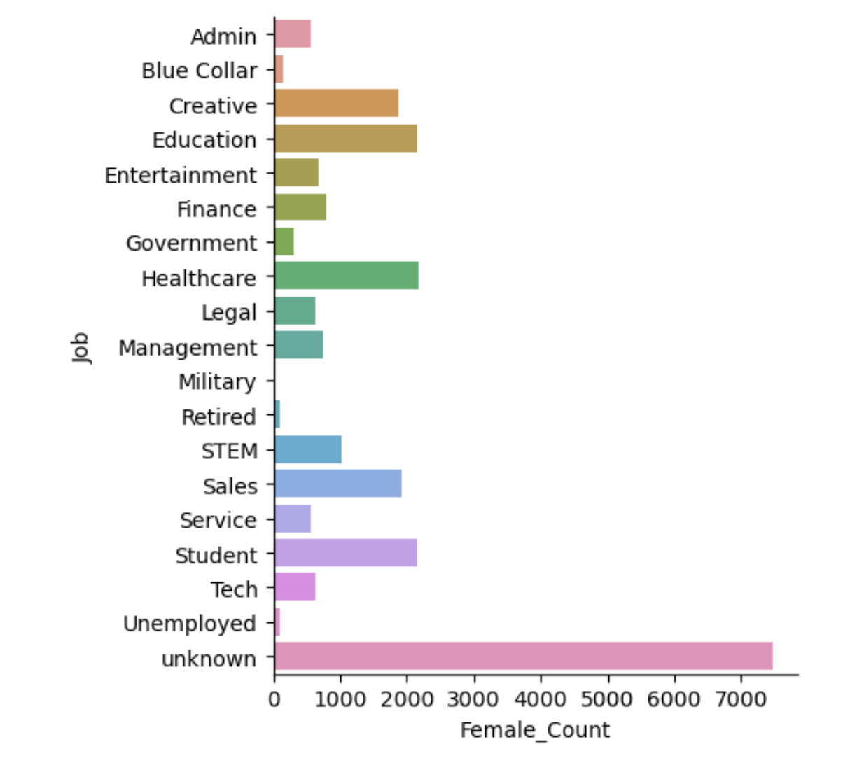
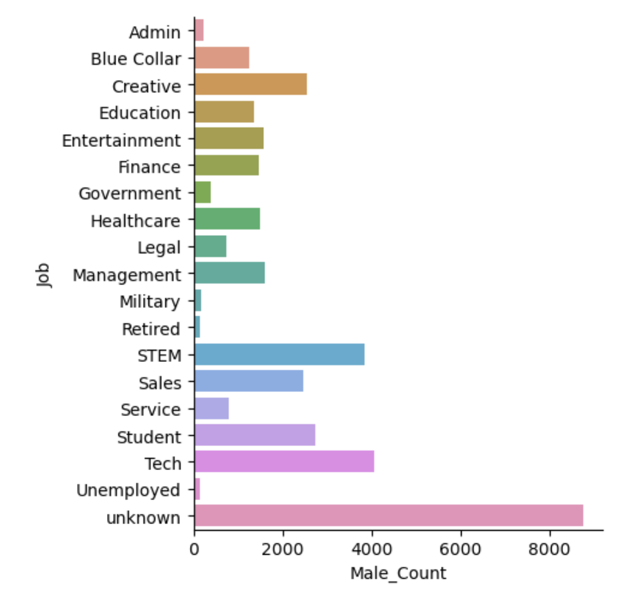
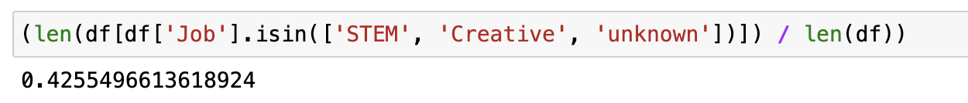
Safe Bets to Hack The System - Job/Offsprings/Religion/Pets
Notes:
Finding – People are clever enough to pickup generic choices and preferences to get more matches. So, that they can get more options.

Slide 31
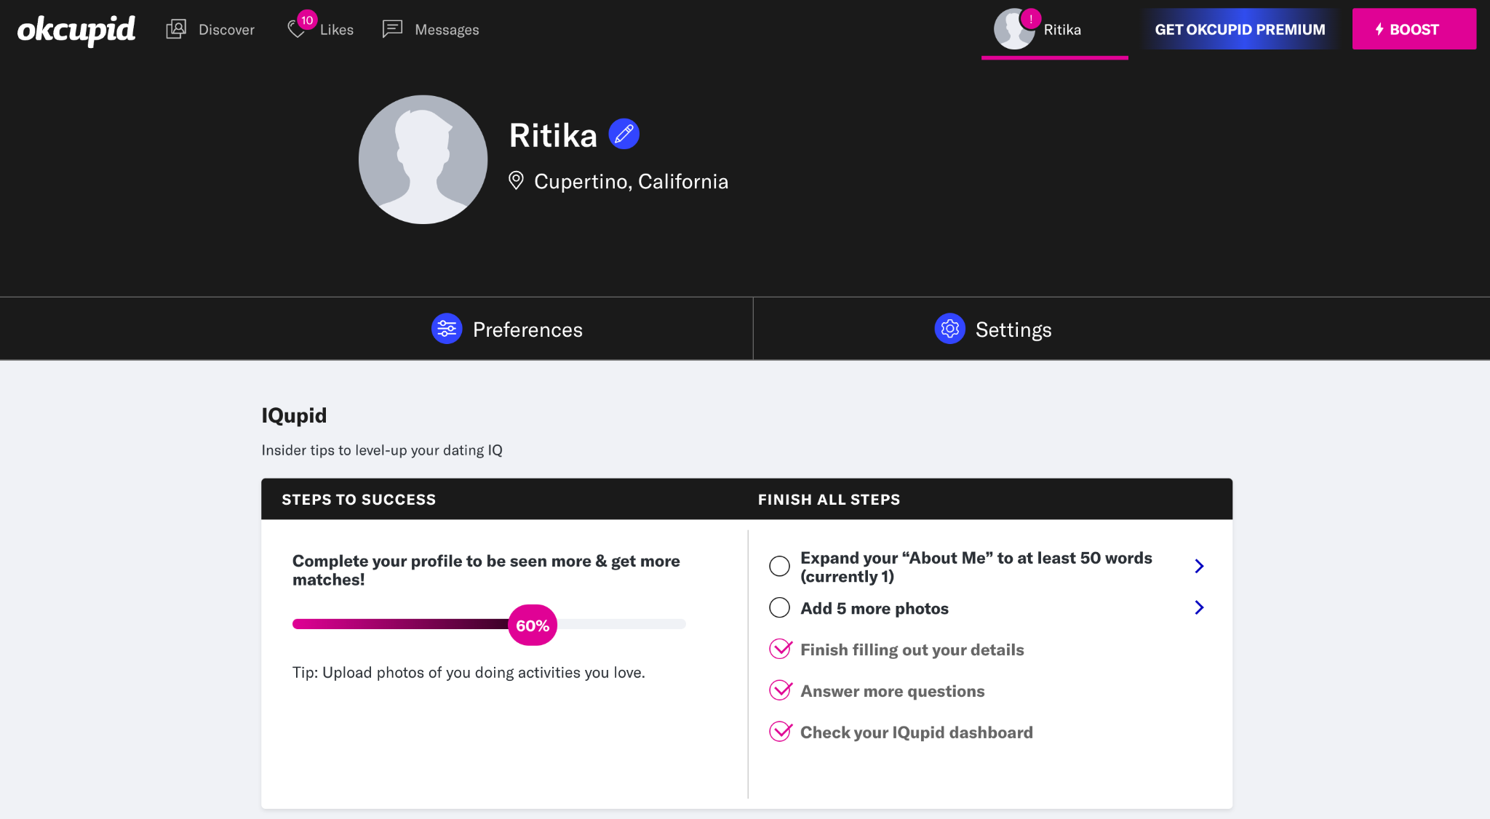
Profiles on Okcupid
Notes:
It is still taking “prefer not to say” / generic values in account to be part of the larger set, which resulted in 10 likes. Proving it is still better than leaving it blank.

Slide 32
Product Improvements
Managerial Recommendation:
“We connect you on what matters.”
GenAI Recommendation- To improve & complete personal profile
Include features to add legitimacy of the profile - Matches can highlight specifics
Leveraging metadata for benefits - e.g. hotel discounts for wanderers
Notes:
To be inline with the company’s tagline –
First way, is through genAI which would help users to fill essay column.
Once a match is confirmed only those users can highlight the choices for the matching partner.
Collaborate with vendor to monetize the product and provide incentive to the users to complete the profiles.

